Slide 1
Firewall 2/2
Made by John Hallam & Mathias Neerup

Slide 2
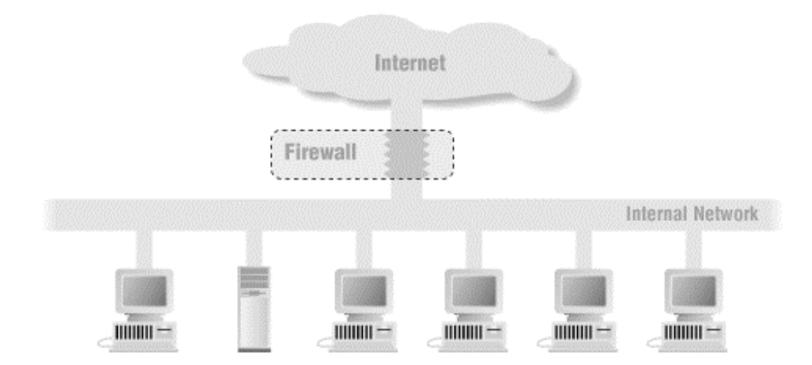
Recap - What is an internet firewall?
Notes:
Intrusion: people logging into your systems (social engineering,
DoS: Loose access to service because you run out of resources.
Flooding attacks are relatively easy to do, but you don’t gain alot “some people just want to see the world burn”
information theft, people claim to be another person, the other person gives out the information etc.
Attackers won’t reveal their identity and location

Slide 3
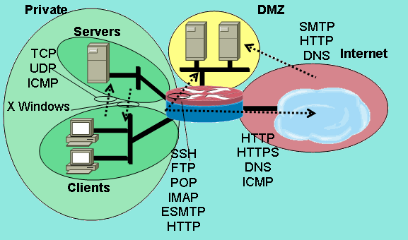
Recap - Firewall Policy
Zones
Backup
VPN users
Hypervisors
Virtual Machines
Management
IOT
Guest
…
Default policy
default deny
allow specific traffic
default permit
deny attacks

Slide 4
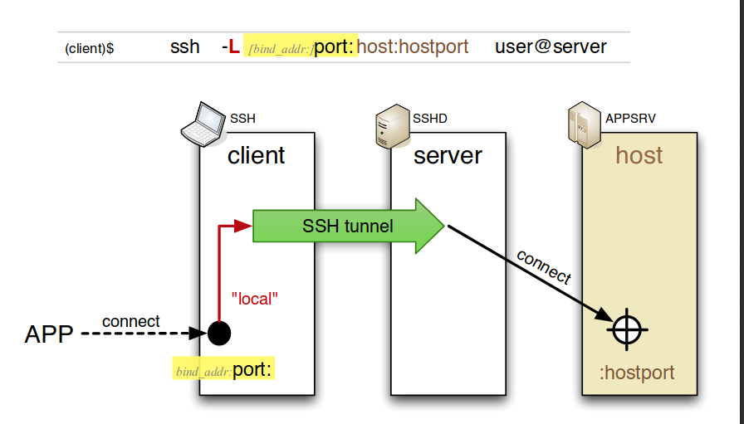
Recap - SSH port forwarding
Local port forwarding
ssh -L 80:intra.example.com:80 gw.example.com -L ..

Slide 5
Recap - SSH port forwarding
Local port forwarding
ssh -L 80:intra.example.com:80 gw.example.com -L ..

Slide 6
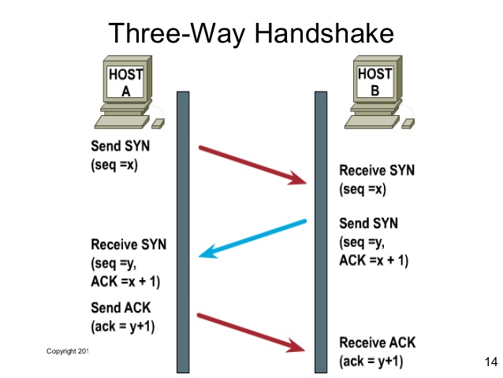
Recap - TCP 3-way handshake

Slide 7
Recap - TCP 3-way handshake

Slide 8
Recap - TCP 3-way handshake

Slide 9
Recap - TCP 3-way handshake

Slide 10
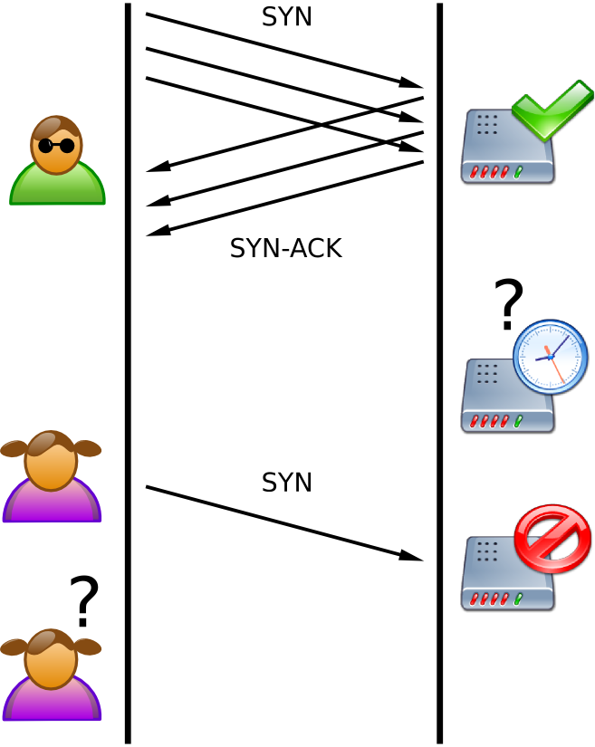
Recap - (D)DoS - SYN flood

Slide 11
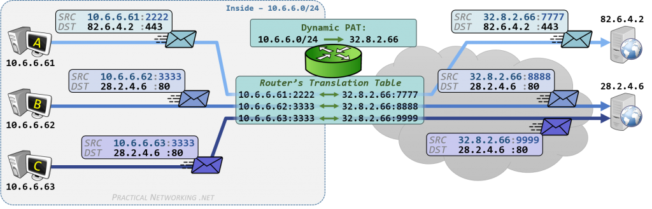
Recap - Dynamic Port NAT(PAT)

Slide 12
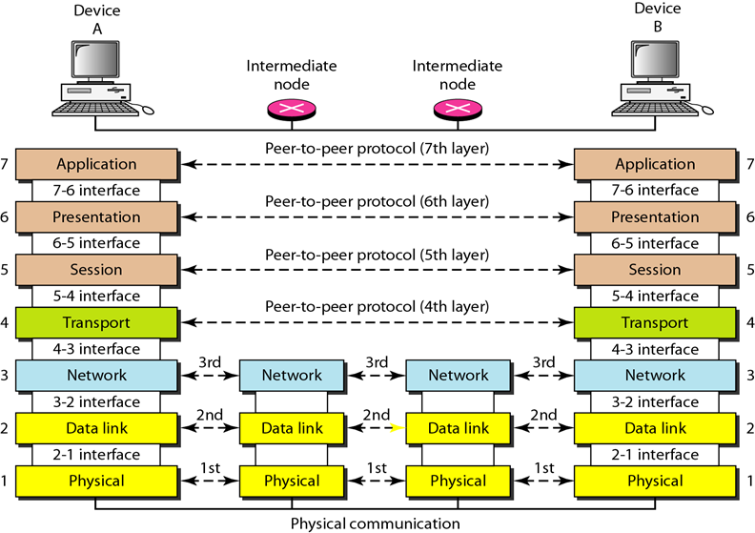
Tunnel layer 2 vs. layer 3
SSH tunnel
VPN tap/tun interface

Slide 13
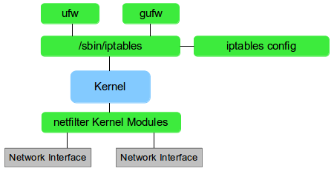
Iptables & Netfilter

Slide 14
man iptables
SYNOPSIS
iptables [-t table] {-A|-C|-D} chain rule-specification
iptables [-t table] -I chain [rulenum] rule-specification
iptables [-t table] -R chain rulenum rule-specification
iptables [-t table] -D chain rulenum
iptables [-t table] -S [chain [rulenum]]
iptables [-t table] {-F|-L|-Z} [chain [rulenum]] [options...]
iptables [-t table] -N chain
iptables [-t table] -X [chain]
iptables [-t table] -P chain target
iptables [-t table] -E old-chain-name new-chain-name
rule-specification = [matches...] [target]
match = -m matchname [per-match-options]
target = -j targetname [per-target-options]

Slide 15
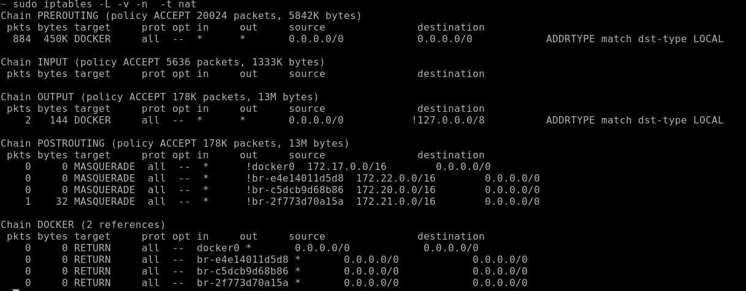
Iptables output

Slide 16
Table & chains
raw
PREROUTING
OUTPUT
filter
INPUT
FORWARD
OUTPUT
nat
PREROUTING
OUTPUT
INPUT
POSTROUTING
mangle
PREROUTING
INPUT
FORWARD
INPUT
POSTROUTING
(security) - SELinux

Slide 17
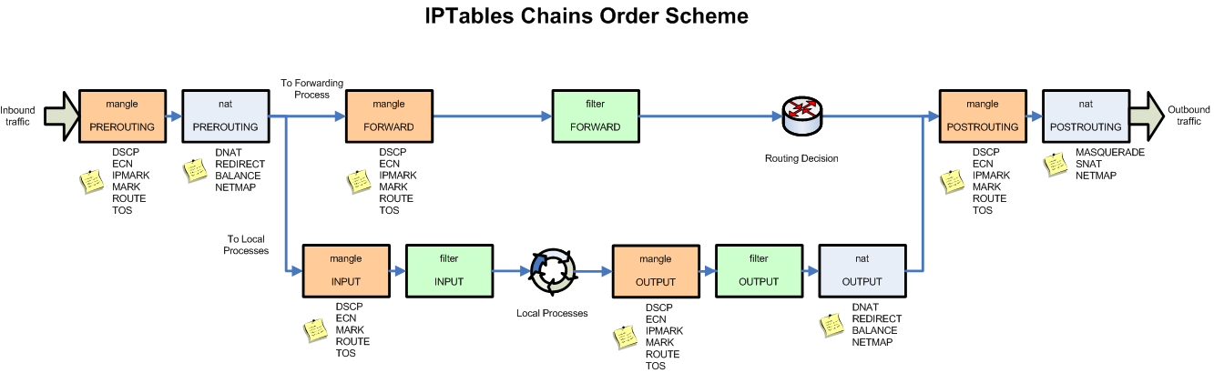
iptables packet flow

Slide 18
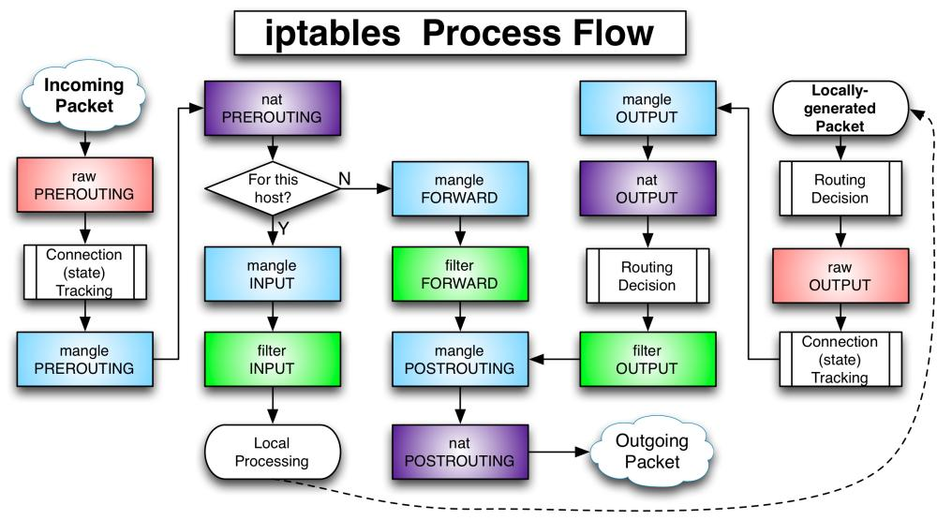
iptables packet flow

Slide 19
iptable - example
sudo iptables -A INPUT -i wlan0 -p udp --dport 53 -j DROP
sudo iptables -A INPUT -i wlan0 -p udp --dport 53 -j REJECT
sudo iptables -A OUTPUT -o wlan0 -p udp --dport 53 -j ACCEPT
Default policy
sudo iptables [-t nat] -P ACCEPT/DROP/REJECT
Statefull firewall
sudo iptables -A INPUT -i wlan0 -p tcp --dport 80 -m state --state NEW,ESTABLISHED -j ACCEPT
sudo iptables -A OUTPUT -o wlan0 -p tcp -m state --state ESTABLISHED -j ACCEPT
Delete:
sudo iptables -D INPUT -i wlan0 -p udp --dport 53 -j ACCEPT
sudo iptables -t filter --flush

Slide 20
Exercise 1/5
Go together in groups - each group should have two RPIs
Verify RPIIXX can access RPIYY’s TCP server on port Z
TCP server: nginx, socat, netcat, ..
TCP client: wget, socat, netcat, ..
Make iptable rule on RPIIYY that DROPs traffic on port Z
Save in .pcap using tcpdump -w
Clear firewall or delete rule
Make iptable rule on RPIIYY that REJECTs traffic on port Z
Transfer the .pcap to your laptop and inspect in wireshark
(30 min)
(hint: use tmux to have more than one terminal on your PI)

Slide 21
Exercise 2/5
On RPIYY:
Create chain in filter table called “www-drop” that drops all http traffic
Jump to “ssh-drop” if dport == 80 from INPUT chain
Verify RPIXX can’t access RPIIYY on port 80
(30 min)

Slide 22
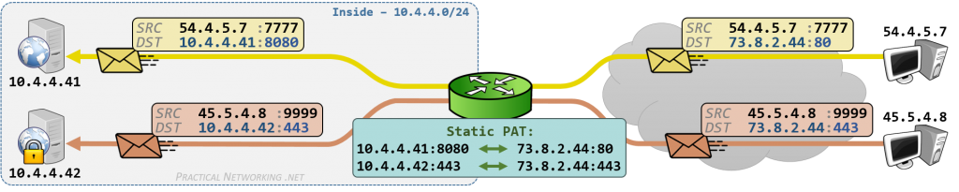
DNAT (static PNAT)

Slide 23
Iptables - DNAT
sudo iptables -t nat -A PREROUTING -p tcp -d 73.8.2.44 --dport 80 -j DNAT --to-destination 10.4.4.41

Slide 24
Iptables - DNAT
sudo iptables -t nat -A PREROUTING -p tcp -d 73.8.2.44 --dport 80 -j DNAT --to-destination 10.4.4.41:8080
sudo iptables -t nat -A PREROUTING -p tcp -d 73.8.2.44 --dport 443 -j DNAT --to-destination 10.4.4.42

Slide 25
Dynamic PNAT
sudo iptables -t nat -A POSTROUTING -o world -j SNAT --to 32.8.2.66

Slide 26
Dynamic PNAT
sudo iptables -t nat -A POSTROUTING -o world -j SNAT --to 32.8.2.66
sudo iptables -t nat -A POSTROUTING -o world -j MASQUERADE

Slide 27
Exercise 3/5
Add IP to eth0 interface that is not in same subnet as the existing IP on eth0
sudo ip addr add 172.16.0.5/24 dev eth0
Bind TCP server to listen on that address only
Create DNAT rule such that you can access RPIYY from RPIXX

Slide 28
Scapy
Scanning
Tracerouting
Probing
Unit tests
Attacks
Network discovery
Penetration testing
Python
Interactive
Great documentation
Lots of tutorials

Slide 29
Exercise 4/5
Install python and scapy on RPIXX
sudo apt install python python-scapy -y
Download code:
https://gist.github.com/Exchizz/d471d8eb968996c772567898ecd7e46d
(hint: wget)
Run and verify success 3-way handshake
Run ss -at4n on RPIXX to verify connections
Modify code to resend SYN in a while-loop
Run ss again and see what’s happening
Talk to your buddy about what is happening
(45 min)

Slide 30
Exercise 4/5
Install python and scapy on RPIXX
sudo apt install python python-scapy -y
Download code:
https://gist.github.com/Exchizz/d471d8eb968996c772567898ecd7e46d
(hint: wget)
Run and verify success 3-way handshake
Run ss -at4n on RPIXX to verify connections
Modify code to resend SYN in a while-loop
Run ss again and see what’s happening
Talk to your buddy about what is happening
http://www.linux-admins.net/2010/09/linux-tcp-tuning.html
Break 10 min!

Slide 31
Firewall 2 - cont’d
Made by John Hallam & Mathias Neerup

Slide 32
Recap - iptables packet flow

Slide 33
Recap - iptables packet flow

Slide 34
Recap - iptables - DNAT
sudo iptables -t nat -A PREROUTING -p tcp -d 73.8.2.44 --dport 80 -j DNAT --to-destination 10.4.4.41:8080
sudo iptables -t nat -A PREROUTING -p tcp -d 73.8.2.44 --dport 443 -j DNAT --to-destination 10.4.4.42

Slide 35
Recap - Dynamic PNAT
sudo iptables -t nat -A POSTROUTING -o world -j SNAT --to 32.8.2.66
sudo iptables -t nat -A POSTROUTING -o world -j MASQUERADE

Slide 36
Recap - Exercise 4/5
Install python and scapy on RPIXX
sudo apt install python python-scapy -y
Download code:
https://gist.github.com/Exchizz/d471d8eb968996c772567898ecd7e46d
(hint: wget)
Run and verify success 3-way handshake
Run ss -at4n on RPIXX to verify connections
Modify code to resend SYN in a while-loop
Run ss again and see what’s happening
Talk to your buddy about what is happening
http://www.linux-admins.net/2010/09/linux-tcp-tuning.html
Break 10 min!

Slide 37
Recap - iptable - example
sudo iptables -A INPUT -i wlan0 -p udp --dport 53 -j DROP
sudo iptables -A INPUT -i wlan0 -p udp --dport 53 -j REJECT
sudo iptables -A OUTPUT -o wlan0 -p udp --dport 53 -j ACCEPT
Default policy
sudo iptables [-t nat] -P ACCEPT/DROP/REJECT
Stateful firewall
sudo iptables -A INPUT -i wlan0 -p tcp --dport 80 -m state --state NEW,ESTABLISHED -j ACCEPT
sudo iptables -A OUTPUT -o wlan0 -p tcp -m state --state ESTABLISHED -j ACCEPT
Delete:
sudo iptables -D INPUT -i wlan0 -p udp --dport 53 -j ACCEPT
sudo iptables -t filter --flush

Slide 38
Iptables - Mitigate syn flood
Limit connections
sudo iptables -A INPUT -p tcp --syn -m limit --limit 1/s --limit-burst 3 -j DROP
- only same source address
Limit connections to port
sudo iptables -A INPUT -p tcp --dport 80 -m connlimit --connlimit-above 5 -j DROP
Large downloads..
Syn cookies

Slide 39
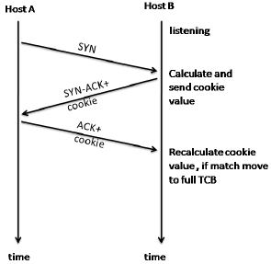
Iptables - Mitigate syn flood
Limit connections
sudo iptables -A INPUT -p tcp --syn -m limit --limit 1/s --limit-burst 3 -j DROP
- only same source address
Limit connections to port
sudo iptables -A INPUT -p tcp --dport 80 -m connlimit --connlimit-above 5 -j DROP
Large downloads..
Syn cookies

Slide 40
Mitigate login attempts
fail2ban
logs
iptables
denyhost

Slide 41
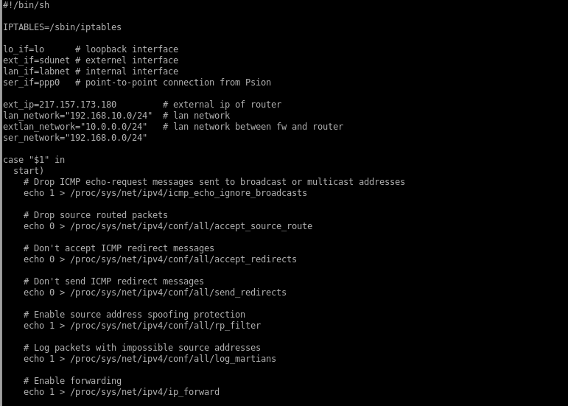
Iptables - native scheme

Slide 42
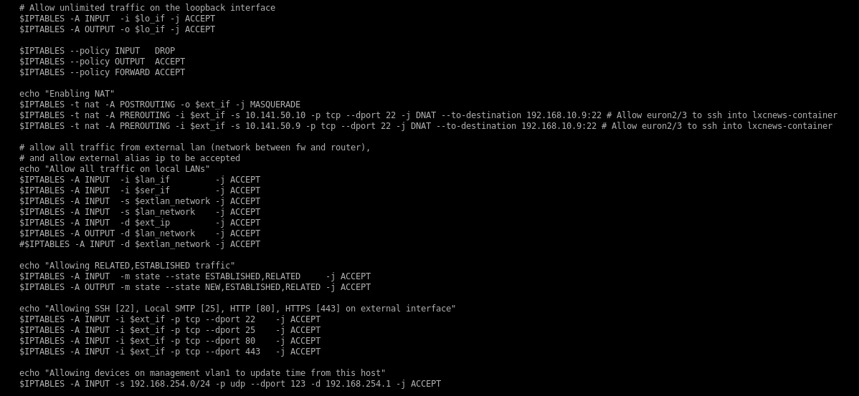
Iptables - native scheme

Slide 43
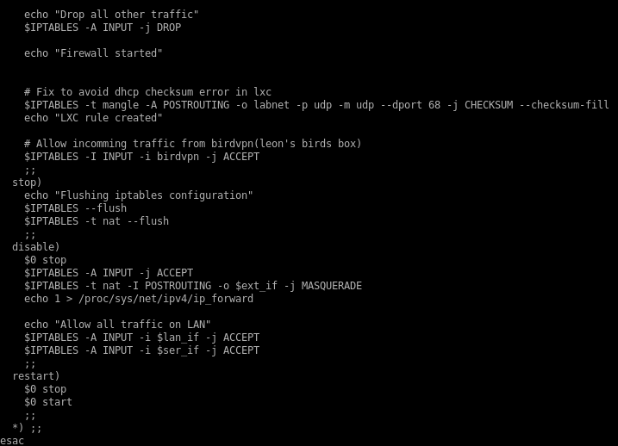
Iptables - native scheme

Slide 44
Iptables - native scheme
Low maintainability
No overview
Difficult to generate

Slide 45
Iptables scheme (By John Hallam)
proto.sh
policy.sh
vars.sh
(nat.sh)
(spoof.sh)
up.sh

Slide 46
Iptables scheme - proto.sh
# Openvpn(lab) PROTOCOL
iptables -N vpn-lab-c2s
iptables -N vpn-lab-s2c
# VPN-lab connection client to server
iptables -A vpn-lab-c2s -p tcp --dport 443 --sport $UNPRIV -m state --state NEW,ESTABLISHED -j ACCEPT
# VPN-lab responses server to client
iptables -A vpn-lab-s2c -p tcp --sport 443 -m state --state ESTABLISHED -j ACCEPT
# SECURE SHELL PROTOCOL
iptables -N ssh-c2s
iptables -N ssh-s2c
# ssh connection client to server
iptables -A ssh-c2s -p tcp --dport ssh -m state --state NEW,ESTABLISHED -j ACCEPT
# ssh responses server to client
iptables -A ssh-s2c -p tcp --sport ssh -m state --state ESTABLISHED -j ACCEPT

Slide 47
Iptables scheme - policy.sh
iptables -N ServerIn
iptables -A ServerIn -j dns-s2c # Server is DNS client
iptables -A ServerIn -j http-c2s # Server is HTTP server
iptables -A ServerIn -j ping-s2c # Server can receive ICMP request
iptables -N ServerOut
iptables -A ServerOut -j dns-c2s # Server is DNS client
iptables -A ServerOut -j http-s2c # Server is HTTP server
iptables -A ServerOut -j ping-s2c # Server can send ICMP request
iptables -N FromWorldToClients
iptables -A FromWorldToClients -j icmp-ok # Permitted ICMP packets
iptables -A FromWorldToClients -j http-s2c # HTTP response to clients permitted
iptables -N FromInternalToWorld
iptables -A FromWorldToClients -j icmp-ok # Permitted ICMP packets
iptables -A FromWorldToClients -j http-c2s # HTTP requests to world is permitted
iptables -A INPUT -i $WORLD_IF -d $WORLD_IF_IP -j ServerIn
iptables -A OUTPUT -o $WORLD_IF -d $WORLD_IF_IP -j ServerOut
iptables -A FORWARD -i $WORLD_IF -o $INTERNAL_IF -j FromWorldToInternal
iptables -A FORWARD -i $INTERNAK_IF -o $WORLD_IF -j FromInternalToWorld

Slide 48
Iptables scheme - vars.sh
# Config. variables
LOOPNET=127.0.0.0/8
# world is the lower network port, near the power plug
CLUSTERNET=10.141.50.0/24
CLUSTER_IF=world
CLUSTER=10.141.50.11
SVCNET=169.254.128.1
# LabVPN
LABVPNNET=192.168.10.0/24
LABVPN_IF=labvpn
LABVPN=192.168.10.200

Slide 49
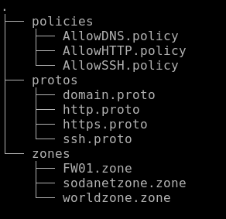
Firewall compiler (FWC) - zones
AllowSSH.policy:
Policy ssh:
Sodanet=>World
Sodanet=>FW01

Slide 50
Firewall compiler (FWC) - zones
AllowSSH.policy:
Policy ssh:
Sodanet=>World
Sodanet=>FW01
sodanetzone.zone:
Sodanet{vlan5} is at 10.10.10.0/24

Slide 51
Firewall compiler (FWC) - zones
AllowSSH.policy:
Policy ssh:
Sodanet=>World
Sodanet=>FW01
sodanetzone.zone:
Sodanet{vlan5} is at 10.10.10.0/24
ssh.proto:
iptables -A %%CHAIN%% -p tcp --dport %%DPORT%% --sport $UNPRIV -m state --state NEW,ESTABLISHED -j ACCEPT
iptables -A %%CHAIN%% -p tcp --sport %%SPORT%% --dport $UNPRIV -m state --state ESTABLISHED -j ACCEPT

Slide 52
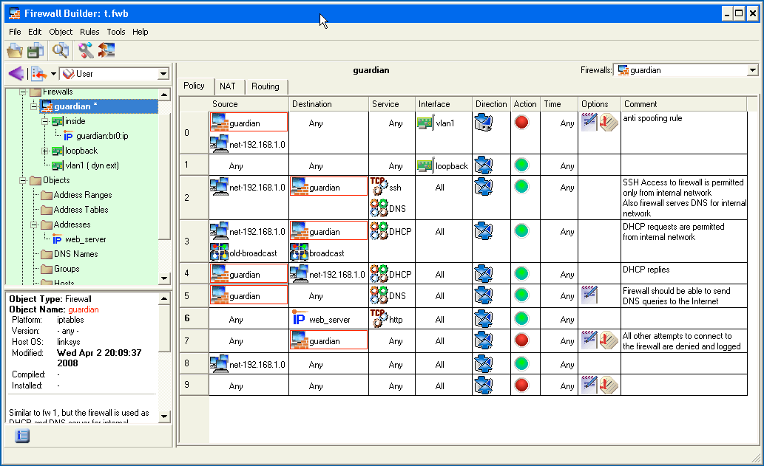
Alternative firewalls
Iptables
Firewall builder

Slide 53
Alternative firewalls
Iptables
Firewall builder
Ufw (Uncomplicated Firewall)
ufw allow http
ufw deny in on eth0 from 15.15.15.51

Slide 54
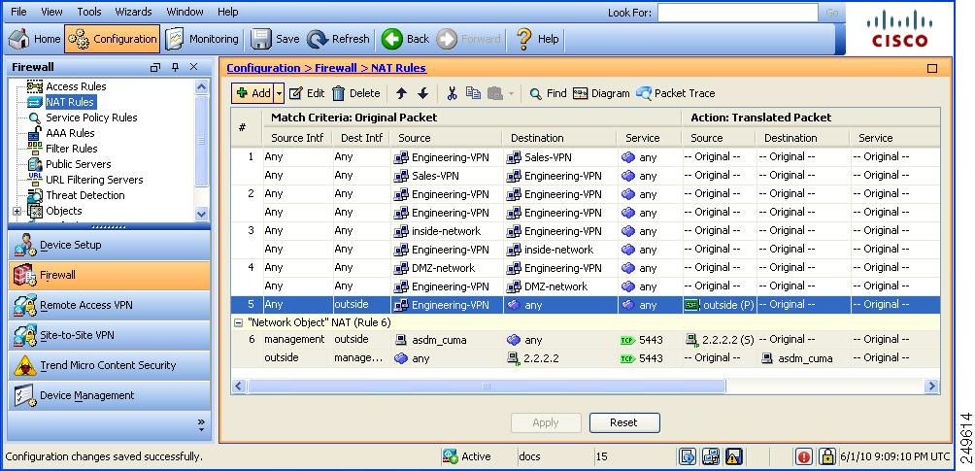
Alternative firewalls
Iptables
Firewall builder
Ufw (Uncomplicated Firewall)
Cisco’s ASA

Slide 55
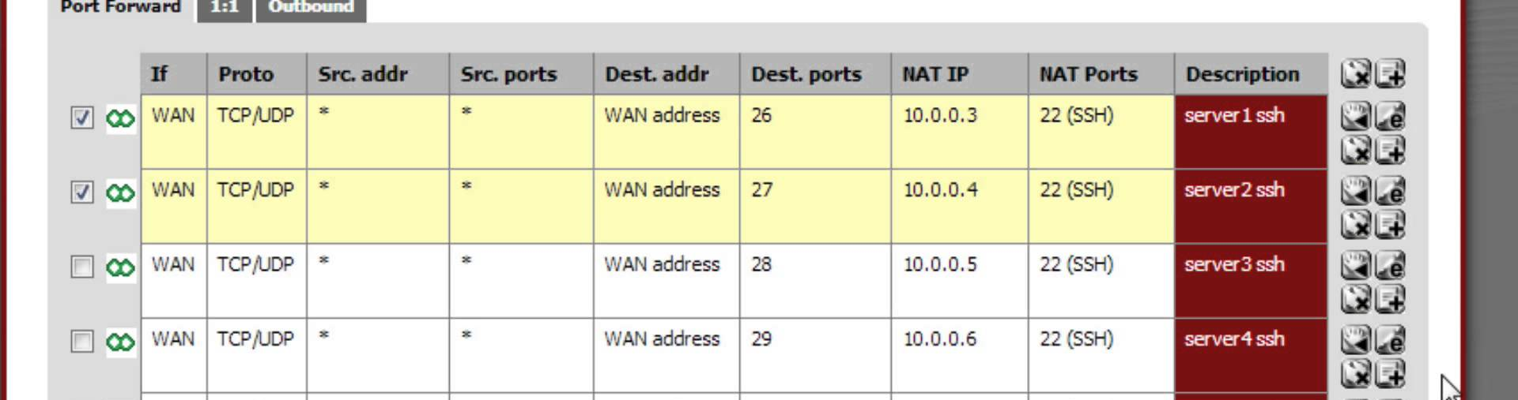
Alternative firewalls
Iptables
Firewall builder
Ufw (Uncomplicated Firewall)
Cisco ASA
Pfsense

Slide 56
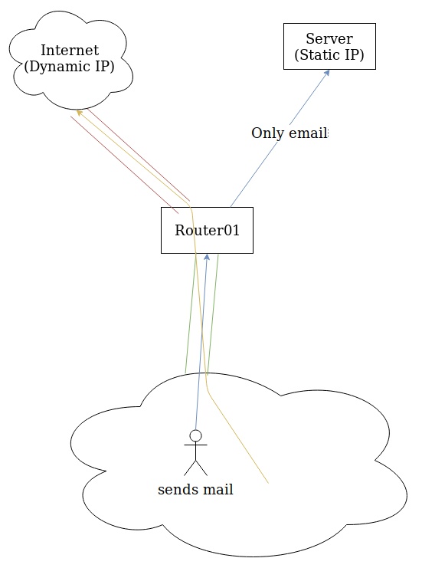
Policy based routing

Slide 57
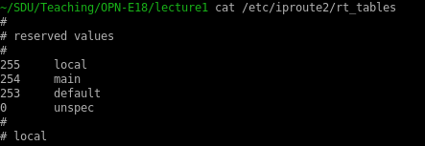
Policy based routing
cat /etc/iproute2/rt_tables
iptables -A PREROUTING -i eth0 -t mangle -p tcp --dport 25 -j MARK --set-mark 1

Slide 58
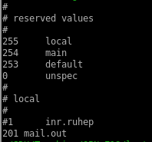
Policy based routing
cat /etc/iproute2/rt_tables
iptables -A PREROUTING -i eth0 -t mangle -p tcp --dport 25 -j MARK --set-mark 1
echo 201 mail.out | sudo tee -a /etc/iproute2/rt_tables

Slide 59


Policy based routing
cat /etc/iproute2/rt_tables
iptables -A PREROUTING -i eth0 -t mangle -p tcp --dport 25 -j MARK --set-mark 1
echo 201 mail.out | sudo tee -a /etc/iproute2/rt_tables
ip rule add fwmark 1 table mail.out
ip route add default via <gw> table mail.out
ip route show table mail.out

Slide 60
Policy based routing

Slide 61
Exercise 5/5
Syn flood RPII13
Let’s see if we still can access it!

